Slide 1
The Three Sisters: Partnership Roles of Research, Library and LIS Education (LISE) Towards Information Literacy Skills in the Workplace
2nd IL Seminar CPUT 2022 - Keynote
Prof. Dennis Ocholla, PhD,
University of Zululand, South Africa
Ochollad@unizulu.ac.za

Slide 2
CONTENT
What is information Literacy and its purpose
What are the IL components?
IL and Digital Literacy
The partnership role of the three sisters
Library role
Research role
LISE role
Challenges and opportunities
Conclusions

Slide 3
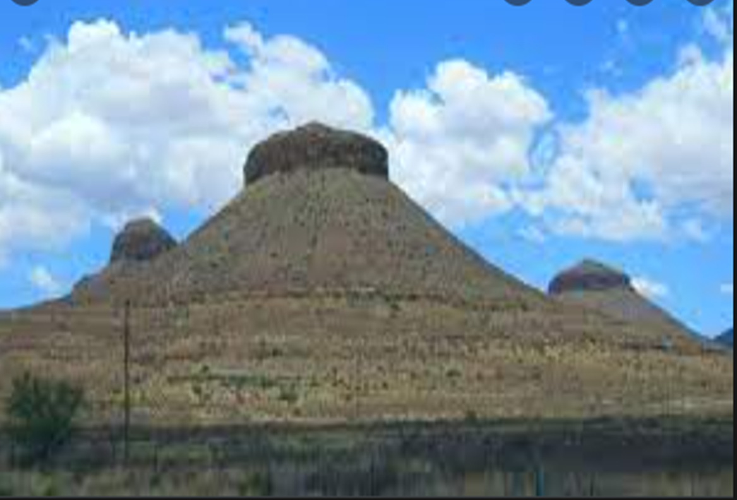
Three Sisters mountain in the Karoo

Slide 4
What is IL and Its Purposes? (see also Dorudolu and Ocholla, 2017)
Information Literacy (IL)
Information seeking
Critical thinking & evaluation
Information use
Information ethics
Information sources
Research methods
Information retrieval
Other / New literacies eg MML/DL
IFLA (2006, 17) define information literacy as the ‘ability to identify when information is needed; carry out a specific task; problem-solve; cost-efficiently search for information; organize or reorganize sources of information; interpret, analyze and retrieve necessary information; appraise the accuracy and reliability of the information; and observe the ethical use of information sources’.
PURPOSES of IL
Find and evaluate information from multiple sources
Enable life - long learning
Enable critical thinking and problem solving
Enable self –learning, self -determination, independence, freedom
Enable responsible and effective use of information
Enable research capacity building and support T&L
Support ethical use information, and prevent fabrication, falsification and plagiarism.
Fig 1: IL components

Slide 5
WHAT IS INFORMATION LITERACY?

Slide 6
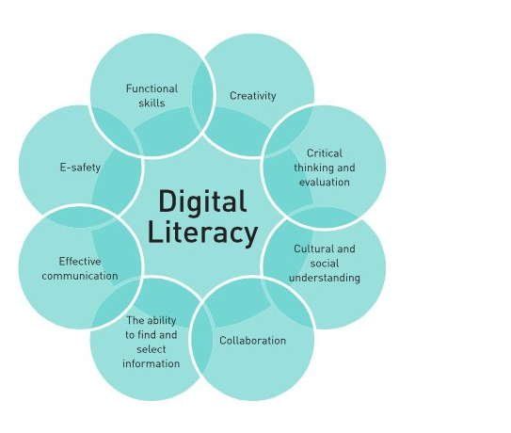
What is digital literacy?
Digital Literacy is the ability and skill to find, evaluate, utilise, share, and create content using information technologies and the Internet
( see https://www.twinkl.co.za/teaching-wiki/digital-literacy)
Components of Digital Literacy: The eight components include creativity, critical thinking and evaluation, cultural and social understanding, collaboration, find and select information, effective communication, e-safety, and functional skills (Hague & Payton, 2010, p. 19).
Fig.3: Digital literacy

Slide 7
IL Frameworks
Access to information and knowledge has been declared a fundamental human right and an essential social justice component. Thus,
1. Applied ethics theoretical perspective - virtue, deontology/duty, rights, utilitarianism . Rights- ‘the claim we have towards others not to harm nor kill us’.This implies that the right I have become the duty of others.’ In other words, right-based theory propounds that ‘we have some rights merely by virtue of being humans’.
2. United Nations organisations( eg UNESCO), policies, declarations, agreements e.g. the Universal Declaration on Human Rights (UNDHR, 1948),WSIS, SDG.
3. Individual states and governments – constitution, laws and policies ( eg South African Bill of Rights). Such interventions are expressed in the rights to literacy, education, expression, association, and other means that promote such access.
4. Research and publications in many forms.
Overwhelmingly, the studies consider access to information and knowledge to be an essential part of social justice( e.g. Lor and Britz 2007, p. 1) - question ‘whether an information society and, more critically, a knowledge society can develop in the absence of freedom of access to information, freedom of expression and freedom to access the digital economy’. ( see Ocholla, 2021)
5. IL theories/models e.g. The seven pillars of IL, The big six skills, etc. (see Chipeta,2010:23)
The Universal Declaration of Human Rights, Article 19, states “that everyone has the right to freedom of opinion and expression; that this right includes freedom to hold opinions without interference and to seek, receive and impart information and ideas through any media and regardless of frontiers” (WSIS, 2005:9). ETHICAL PERSPECTIVE – ACCESS to INFORMATION

Slide 8
Three Sisters - What does Partnership Entail?
WORKING TOGETHER TOWARDS A COMMON GOAL
PARTNERSHIP OR COLLABORATION CAN BE:
Optimist - Focus on benefits rather than immediate reward or risks
Pessimist – Focus on influence and dominance of parties involved (eg RDT) proposed by Pfeffer and Salancik in 1978 - It is opportunistic
Realist - Focuses on the prevailing situation at the time of a collaborative project ( see Alter and Hage’s (1993) evolutionary Theory, e.g. several factors influence the viability of a collaborative initiative i.e. PEST
Also see ANT, SNT, SCT ( see Sullivan and Skelcher’s 2002, Ocholla 2008, Fari and Ocholla 2018)

Slide 9
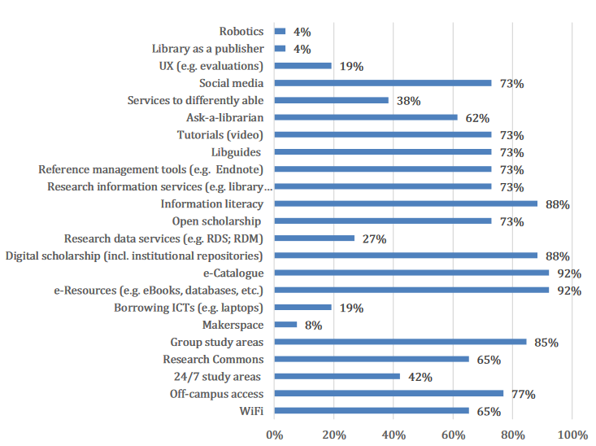
The role of Library (see Ocholla & Ocholla, 2020:361)
Figure 4. Current trends in SA academic libraries

Slide 10
Source: Ocholla & Ocholla, 2020
Fig.5: Responsiveness of SA academic libraries to the trends/services

Slide 11
IL Strategy in the Workplace
Policy/Guidelines
Planning – What (e.g. IL programmes and activities)? Why? How? Who? When( timeframe)? Where? Whom (e.g. target)? Outcome?
Stakeholders - Institution, Library users, Librarians/information providers, Faculty/staff, Research office, PA – e.g. LIASA
Capacity building – CSW( see also Raju ,2014)
Visibility – Promotion/Marketing/Web presence

Slide 12
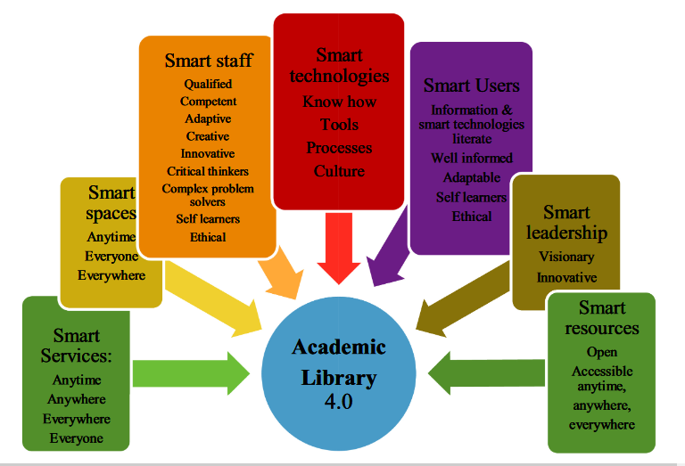
The requirement of the Library (see Ocholla and Ocholla, 2020: 364)
Academic
Library 4.0
Smart Services:
Anytime
Anywhere
Everywhere
Everyone
Smart staff
Qualified
Competent
Adaptive
Creative
Innovative
Critical thinkers
Complex problem solvers
Self learners
Ethical
Smart technologies
Know how
Tools
Processes
Culture
Smart Users
Information & smart technologies literate
Well informed
Adaptable
Self learners
Ethical
Smart spaces
Anytime
Everyone
Everywhere
Smart leadership
Visionary
Innovative
Smart resources
Open
Accessible anytime,
anywhere,
everywhere
Fig.6: Academic library 4.0
Notes:
CPD + IL education + Research (eg UX) + CWS + computer literacy? + IL advisory role + social media literacy +

Slide 13
The role of Research
Knowledge creation and dissemination
develop scientific and professional practice
develop creative, analytical and rational thinking for informed decision making
find solutions to challenges or problems affecting humanity
confirm or contest or refute theories or hypothesiss or problems affecting humanity
self development and satisfy curiosity
Mandate- e.g. mission of a university or place of work such as a library
recognition and visibility
Justification of existence
Should librarians conduct and publish? (see Ocholla, Ocholla and Onyancha 2012 and 2013)
Our conclusion was YES and made the following two major suggestions
We suggest that the promotion of university librarians to senior library positions should be linked to research output and publications as they serve a vibrant academic community whose research requirements and services can best be achieved by a person who not only conducts research, but also disseminates research results through scholarly publications..
Most academic librarians are involved with teaching information literacy to the university academic community, such as students and staff, where themes related to e-resources, open access, information ethics is increasingly common.

Slide 14
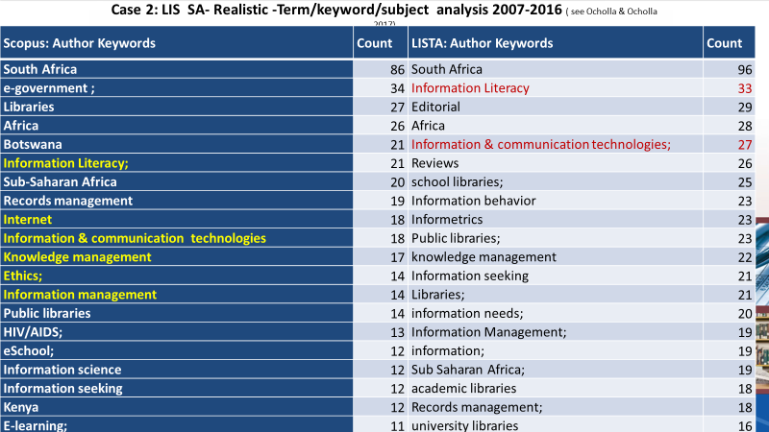
Table 1: Top Author keywords - SCOPUS and LISTA Term/keyword/subject analysis 2007-2016 (see Ocholla & Ocholla 2017)

Slide 15
Main term/keyword/subject clusters | Sub-themes
Information literacy | IS + IR + CL +DL/MML+Inf sources+ IE+NML+
Information and communication technology | e-government, internet, e-school, e-learning, open access, digital divide
Information seeking and retrieval | Information Seeking, Information Behaviour, Information Retrieval, Information Needs
Library/ information service | Public libraries, Academic libraries Information services, Librarians, Open access, School libraries
Knowledge management | Information management, Knowledge management, Information society Records management
Spaces | South Africa, Botswana, Africa, Sub-saharan Africa, Univesities
Others | Information science, Bibliometrics, Research, ethics, legal deposit, collaboration, HiV/AiDs
Table 2. LIS main keyword/subject clusters
( see Ocholla & Ocholla , 2017)

Slide 16
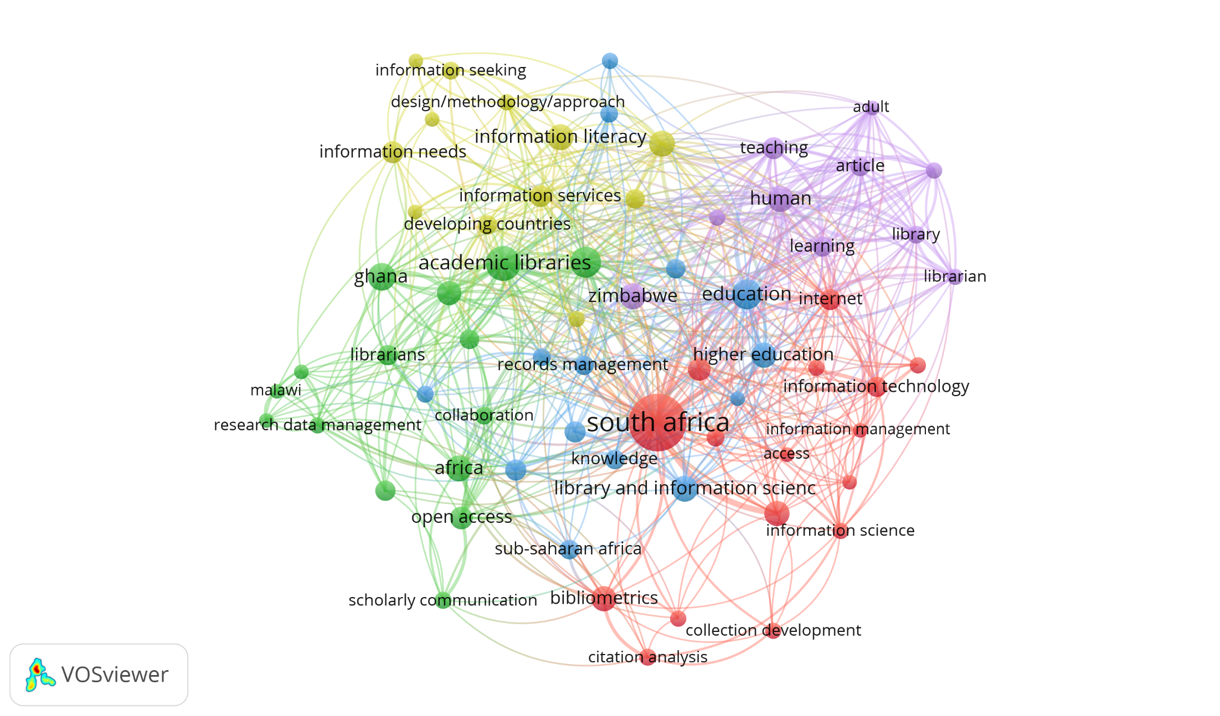
Fig 7:
Library and Information Science Research Keywords/
terms in SCOPUS 2014-2021

Slide 17
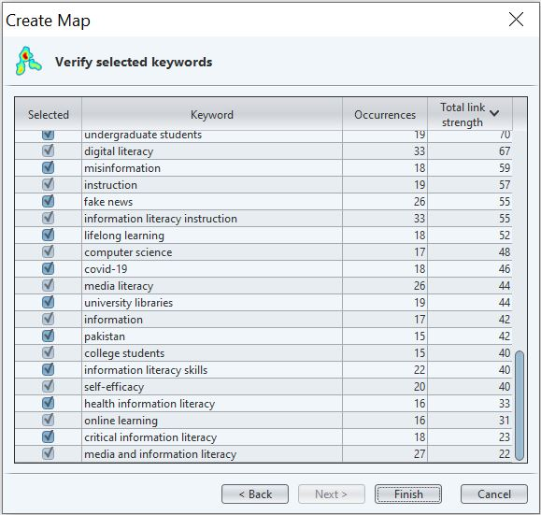
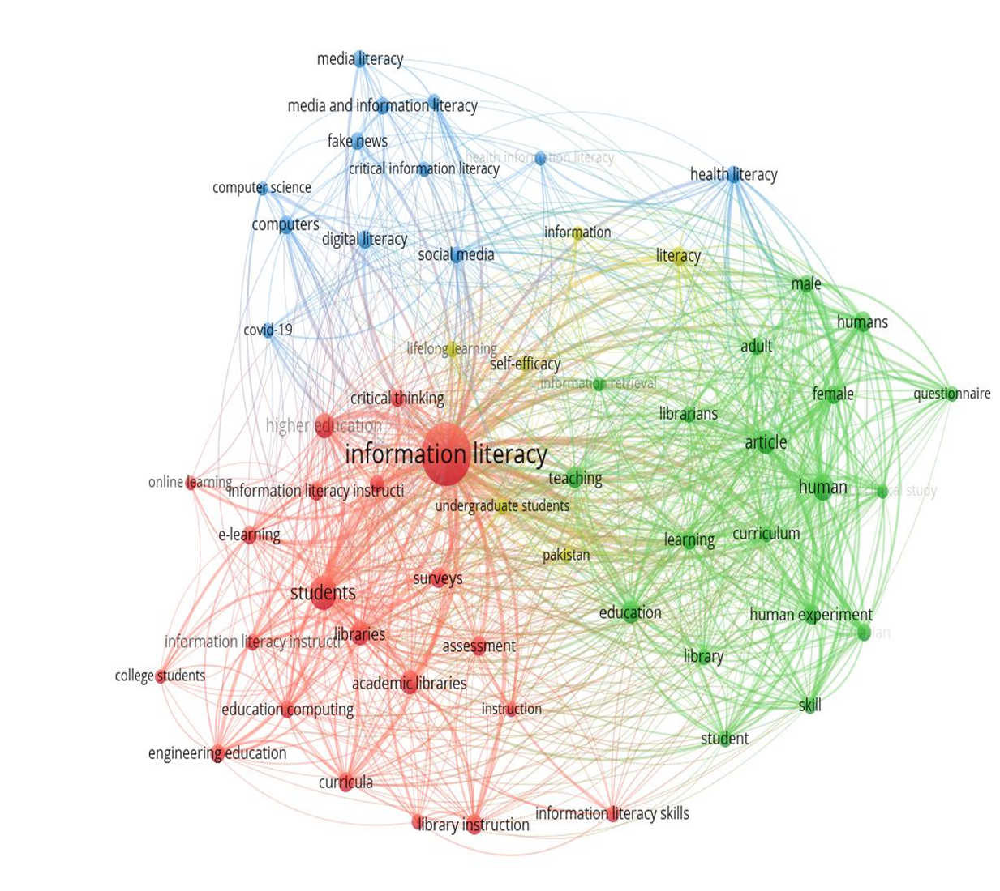
IL linked terms
Fig 8: IL linked terms-Scopus 2017-2022

Slide 18
Types of IL ( see Onyancha ,2020)

Slide 19
1. Research 2. LISE- includes IL curricula Development 3. Community outreach (e.g. CPD + Short courses+ partnership with stakeholders e.g. PA-LIASA, libraries/LIS employers) 4. Advise/Consultancy
The role of LISE( see also Jiyane and Onyancha ,2010)

Slide 20
UNIZULU IL Overlaping Modules/courses
Information Literacy | Title
 | Information Science and Information Literacy
 | Computer literacy and Information Studies
 | Information Searching and Retrieval
 | Information Seeking Behaviour
 | Advanced information Retrieval Indexing and Abstracting
 | Computer Mediated Communication
 | Information Retrieval – 1, 2
 | Research Methodology
 | Information Ethics
 | Informetrics
 | Experiential Learning
 | Cataloguing
 | Classification
 | Multimedia 1,2,3,4
 | Collection Development( Information sources)
Table 3:IL related content modules/course
See-http://reg.unizulu.ac.za/wp-content/uploads/2022/01/Faculty-of-Arts-Handbook-2022.pdf for module/course description

Slide 21
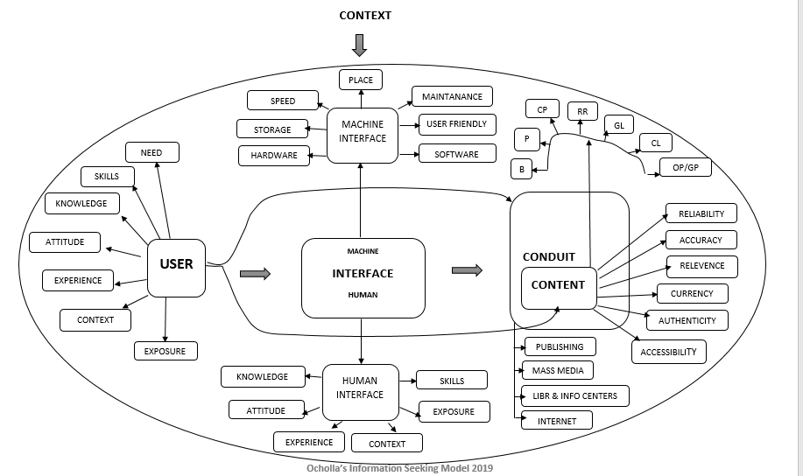
Information seeking and IL
Key:
B- books
P- periodicals
CP- conference proceedings
RP – research reports
GL – Grey literature
CL – commercial literature eg patents
OP/GP – official publications/ government publications
Figure 9: IL and IS link.

Slide 22
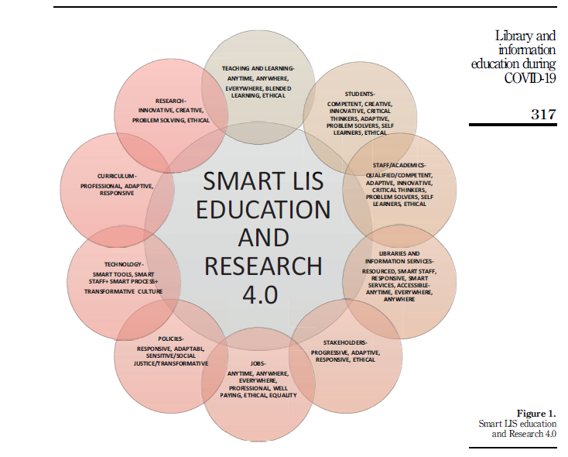
What are the requirements?
See Ocholla, 2020
Fig 10: Smart LIS education and research

Slide 23
Challenges and opportunities
Collaboration/partnership ( see Ocholla, 2008)
Popularization of IL – CSW e.g. regular IL annual conferences
Institutional support
Research support
Library support (e.g. 88% see slide 7 and 8)
LIS education support (e.g. UNIZULU LIS )
Multidisciplinarity of IL( see Onyancha , 2020)
PA, e.g. IFLA, LIASA support
Capacity building
Emerging/new literacies e.g. digital/multimedia, social media etc.

Slide 24
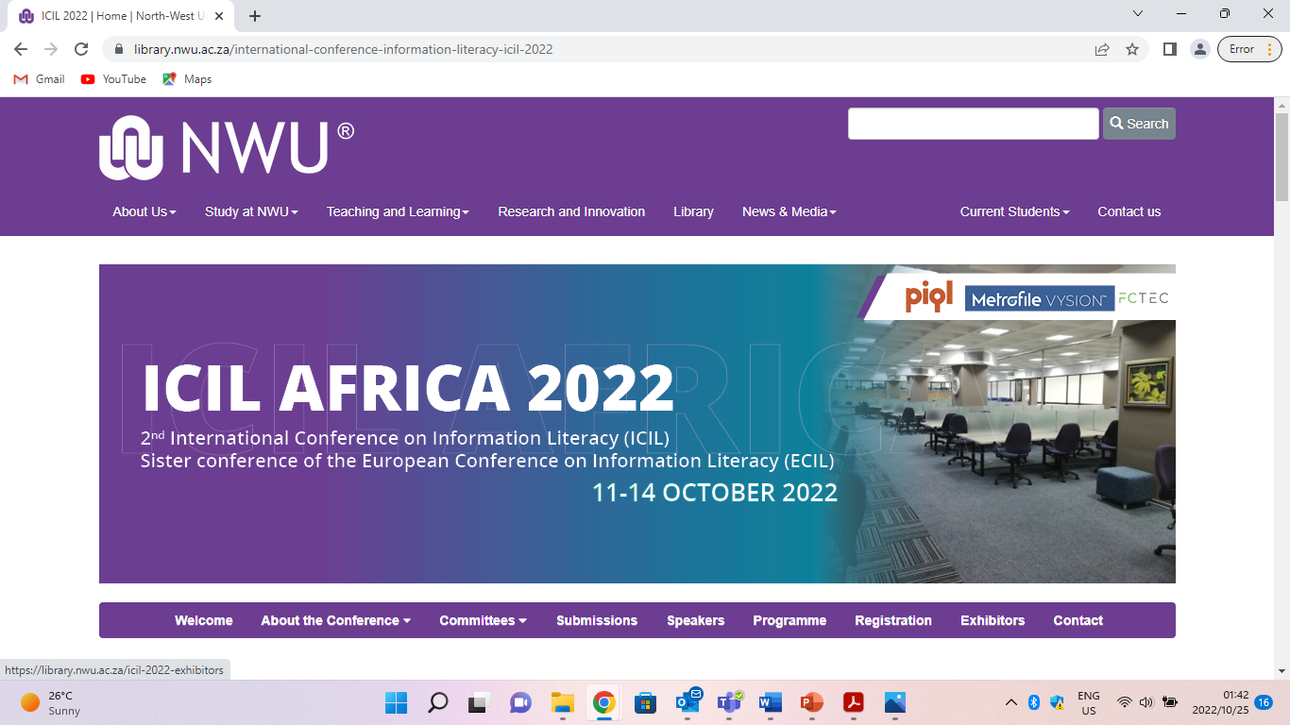
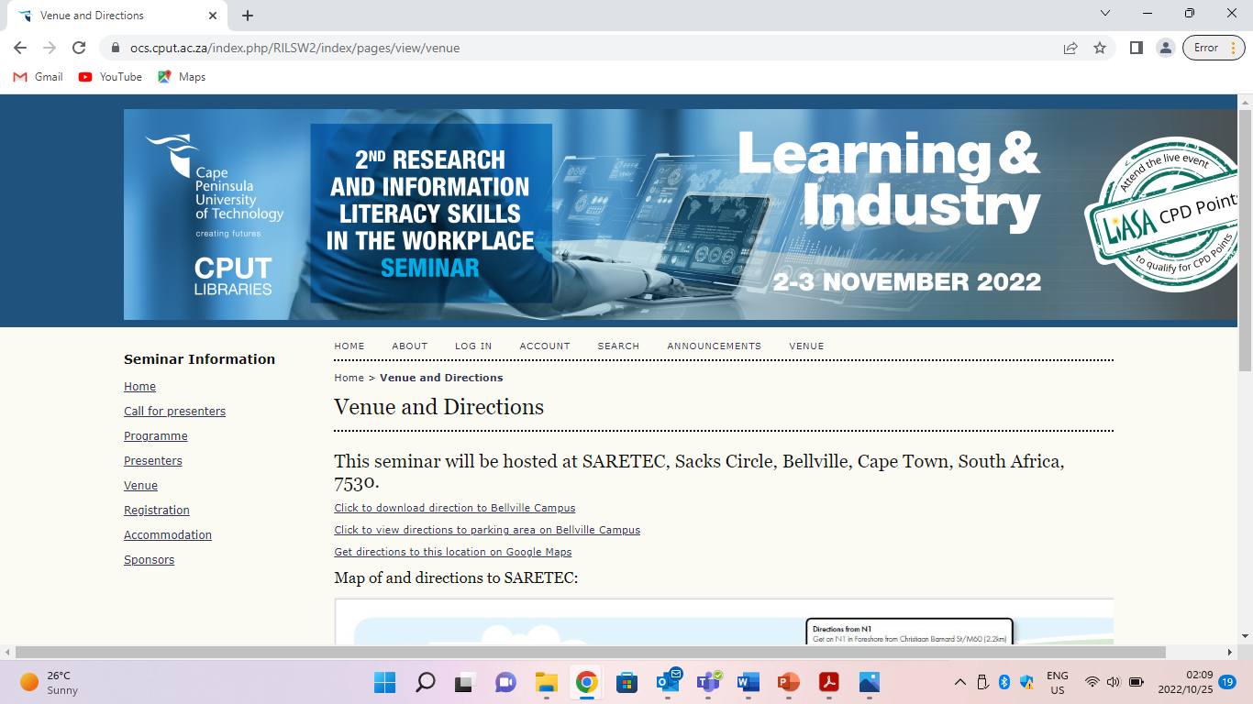

Slide 25
Conclusions
Multidisciplinarity of IL fundamental for its exploration, understanding, integration and development as a LIS discipline/domain. Thus, IL is closely linked to other literacies (e.g. adult education, MML/DL, SML, FL, CL etc.)(see also Onyancha, 2020)
IL is a human right (see e.g. UNDHR) for enabling information access and use therefore ethical considerations should inform and lead its foundation and development.
Libraries and LIS schools should play a leading role for IL Education (both formal and informal - CPD). Variations( e.g. depth and breadth) in their involvement must always considered.
IL should be integrated into the library strategic plan and a unit/section for its coordination and management be established where that does not exist.
Research is essential for IL theory and practice and must be encouraged and supported by stakeholders.
Popularization of IL should be encouraged (e.g. marketing, publicity, web presence)
We should strive to turn the existing IL challenges into opportunities

Slide 26
Readings
Chipeta, G.P.(2010). Information Literacy(IL) Teaching and Learning. A literature review. Inkanyiso.JHSS, Vol 2, N1. ( online)
Durodolu, O.O.; Ocholla, D.N.(2017).Search strategy, self- concept and metacognitive skills of secondary school teachers in selected cities in Nigeria and South Africa. LIBRI :Internartional Journal of Library and Information Science , Vol 62 N2;89-102
Durodolu Oluwole and Ocholla Dennis.(2017). Insight into Information Literacy Skills and Personal Abilities of Secondary School Teachers: Some experiences from Lagos, Nigeria and Durban, South Africa .Third Internartional Professional Forum “ Book, Culture, Education, Innovation”, Crimea 2017, Sudak, Republic of Crimea, Online: http://www.gpntb.ru/win/inter-events/crimea2017/disk/022.pdf
Jiyane, G.V., Onyancha, O.B.(2010) Information literacy education and instruction in academic libraries and LIS schools in institutions of higher education in South Africa.South African journal of libraries and information science 76 (1), 11-23
Kinyanjui, J., & Ocholla, D. (2017, September). Financial Literacy Competencies of Women Entrepreneurs in Kenya. In European Conference on Information Literacy (pp. 348-358). Springer, Cham.
Mudave, E.( 2016). Information Literacy Learning Experiences. A literature Review.Inkanyiso.Journal of Humanities and Social Sciences, Vol 8( 1). file:///C:/Users/Dennis%20Ocholla/Downloads/140005-Article%20Text-373306-1-10-20160720%20(1).pdf
Ocholla,Dennis Ngong.(2021). Information and knowledge access for social justice: Perspectives from Mandela’s Long Walk to freedom. In: Coetzee Bester,Johannes Britz, Rafael Capurro and Rachel Fischer(Eds), Nelson Mandela.A Reader on Information Ethics.Pretoria, ICIE,p 41-61
Ocholla,D.N.(2021). Echoes Down the corridor. Expereinces and perspectives of Library and Information Science Education(LISE) during Covid-19 through an African lens. Library Management Vol 42, 4/5, 305-321
Ocholla, DN (2008), The Current Status and Challenges of Collaboration in Library and Information Science (LIS) Education and Training in Africa. New Library World, Vol.109, No.9/10, 466-479
Ocholla, Dennis N., Ocholla, L., Onyancha, O. Bosire.(2013). Insight into Research Publication Output of Academic Librarians in Southern African Public Universities from 2002 -2011.African Journal of Libraries Archives and Information Science, Vol.23, No1;5-22
Ocholla, Dennis , Ocholla Lyudmila and Omwoyo Bosire Onyancha (2012). Research visibility, publication patterns and output of academic librarians in sub-Saharan Africa: The case of Eastern Africa. Aslib Proceedings, Vol.64(5),478-493
Ocholla, D.N. and Ocholla, L. (2020), "Readiness of academic libraries in South Africa to research, teaching and learning support in the Fourth Industrial Revolution", Library Management, Vol. 41,6/7,355-368
Onyancha, O.B.(2020) Knowledge Visualization and mapping of Information Literacy 1975-2018. IFLA Journal Vol 46 N 2: 107-123
Raju,J.(2014). Knowledge and skills for the digital era academic library. Journal of Academic Librarianship, Vol 40, N2:163-170
Rabatseta, R , Maluleka.R., Onyancha, O.B.(2021. Adoption and use of social media in academic libraries in South Africa.South African Journal of Libraries and Information Science, Vol87(1): 20-31
Authors

