Slide 1
CPUT- Libraries
Where there’s a WIL there’s a way The case of a CPUT branch library’s opportunity to present a workplace information literacy course to a group of Grade-R Diploma students.
Christel Oosthuizen – Faculty Librarian

Slide 2
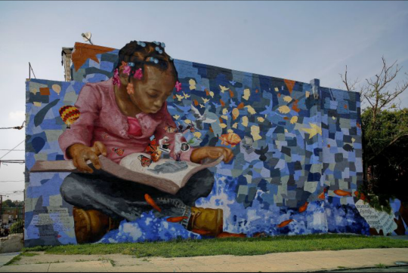
“Literacy is a bridge from misery to hope. It is the road to human progress and the means through which every man, woman and child can realise their full potential.” -Kofi Annan (1997)

Slide 3
The inspiration
Wellington Campus library’s space design
CPUT’s strategic objectives
CPUT Libraries’ research and workplace information literacy seminar (Nov 2019)

Slide 4
2019 Research and Workplace Information Literacy Skills Seminar
As a University of Technology, CPUT focusses on preparing students for industry.
CPUT libraries thus identified the need to improve students’ information skills within a workplace-specific context and, in November 2019, presented a Research and Workplace Information Literacy Skills Seminar.
The purpose of the seminar was to facilitate open discussions between librarians, academics and industry partners with regards to research and information literacy skills within the workplace (CPUT Libraries, 2019).
Another intent of the seminar was to look at how the library could assist in supporting a work-integrated learning (WIL)-philosophy
WIL-philosophy is a pedagogical strategy that enables students to practice and apply their discipline knowledge and build workplace and employability skills while enrolled in their university studies (Winberg, 2019

Slide 5
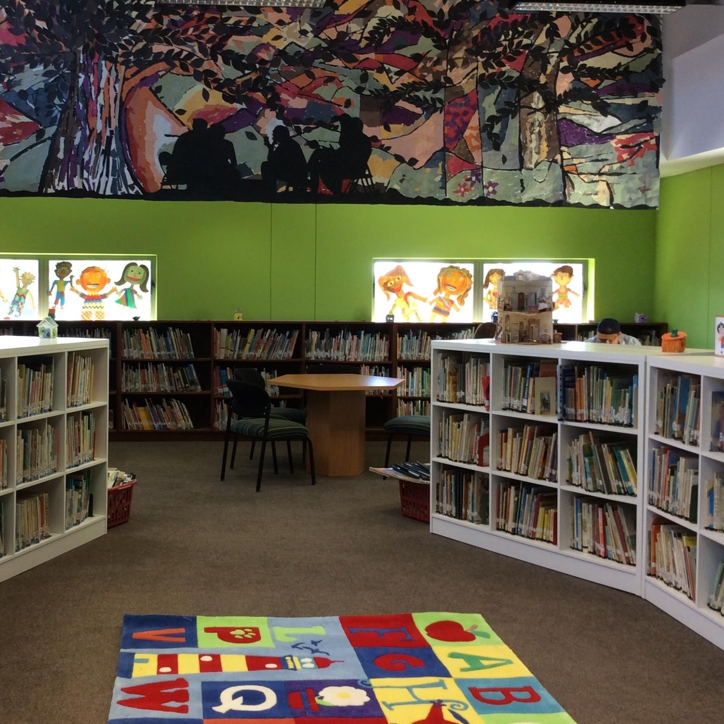
Wellington library’s space design & collections:
Another aspect that stimulated the idea to develop a WIL-course is the Wellington library’s physical space design.
This library consists of two levels with two separate entrances to the library. Academic and research collections are primarily hosted on the ground level, whilst practice teaching collections are hosted on the first level,
This provided the opportunity to create a work-integrated-space/service-design which we refer to as the model school library.
The main intent of this space is to develop library services that mirror education students’ future workplaces.

Slide 6
CPUT’s vision and mision
Vision of CPUT
CPUT is Africa’s leading Smart University of Technology, globally renowned for innovation with graduates who shape a better world for humanity.
Mission of CPUT
CPUT transforms its students through world-class researchers who inspire knowledge production and cutting-edge innovation.

Slide 7
Inspiration + Passion = energy & opportunity
Notes:
After the seminar I was like…

Slide 8
The opportunity:
Request – expanded IL course for 3rd year Grade-R diploma students
Embedded – academic literacy subject
Academic literacy objectives:
Critical evaluation of information
Development of literacy in various genres
Development of student into scholars, researchers & lifelong learners
Encouragement of students’ critical thinking
Suggested WIL objectives:
Development of WIL-skills for educators
Development of students’ knowledge of children’s literature
Creating an awareness of the value of early literacies in developing lifelong learners
- Critical evaluation of workplace specific information

Slide 9
WIL definitions:
Forster (2017:2) - “In a world in which information is the very lifeblood of business and the professions, the quality of performance is dependent on the ability to use information efficiently, effectively and creatively”
Kirton and Barham (2005) - described workplace information literacy as an individual’s ability to locate, access, and apply information for work-related responsibilities and challenges
Van Wyk and Jacobs (2019:32) - defined workplace information literacy as an individual’s ability to solve problems, think critically, act autonomously and to use information in creative and innovative ways within a specific workplace context
Lloyd (2013:10) - “information literate workers draw from a wide range of information sources and engage with information related activities that enable them to know the information landscape of the workplace; to understand how information is situated within it; and, to connect with the performances of work as it happens.”

Slide 10
“Information literacy skills are among the key skills required for success in information-based societies. Consequently, teachers who undertake the responsibility of teaching should possess these skills. Developing a high level of efficacy in these skills will also affect the success of teachers’ work performance and personal success in an increasingly information-based society.”
This quotation by Usluel (2007: 93) confirm the importance workplace information literacy skills within the context of the education profession:

Slide 11
Guiding documents and policies:
The South African norms and standards for teachers (South Africa, 2000)
SAQUA – South African Qualifications Authority’s graduate attributes (Griesel & Parker, 2009)
The Department of Higher Education’s minimum requirements for teacher education qualifications (DHET, 2011)
The United Kingdom’s initial teacher training core content framework (U.K. Department of Education. 2019).

Slide 12
Emergency remote teaching and learning (ERTL):
COVID-19 Pandemic
ERTL “involves the use of fully remote teaching solutions for instruction or education that would otherwise be delivered face-to-face and that will return to that format once the crisis or emergency has abated” (Hodges et al., 2020:6)
Guiding document: CPUT’s ‘Quality Management and Assurance Guidelines for Multimodal, Blended, and Remote Teaching and Learning’ (CPUT, 2020).

Slide 13
Design principles that guided the process

Slide 14
Sir Ken Robinson’s Creative Schools (2016)
Progressive teaching is based on learning by:
Discovery
Self-expression
Small group activities
The flipped classroom – learning at your own pace where the classroom becomes the homework and the homework becomes the classwork

Slide 15
Most important 21st Century skills that students need to be taught are:
Interdisciplinary skills:
Global awareness
Financial/economic/business & entrepreneurial literacy
Civic literacy
Health literacy
Environmental literacy
Learning Skills:
Creativity and innovation
Critical thinking and problem solving
Communication and collaboration
Life and career Skills:
Flexibility and adaptability
Initiative and self-direction
Social and cross-cultural skills
Productivity and accountability
Leadership and responsibility

Slide 16
8 core competencies considered (Robinson, 2016)
Instead of having a curriculum, educational institutions should facilitate 8 core competencies: (Robinson, 2016:135) Curiosity: The ability to ask questions and to explore how the world works (deeper thinking)
Creativity: The ability to generate new ideas and to apply them in practice
Criticism: The ability to analyse info and ideas and to form reasoned arguments & judgements
Communication: The ability to express thoughts and feelings clearly and confidently
Collaboration: The ability to work constructively with others
Compassion: The ability to emphasize with others and to act accordingly
Composure: The ability to connect with the inner life and feelings and to dev a sense of balance
Citizenship: The ability to engage constructively with society and to participate in the processes that sustain it: “Democracy has to be born anew every generation, and education is its midwife” (John Dewey)

Slide 17
Design principles: active learning & assessment for learning

Slide 18
Assessments for learning promoting higher level thinking through Bloom’s taxonomy of educational objectives (1956: 202-207)

Slide 19
WIL-course content and themes:
Essential information resources within the context of Early Childhood education
Open Education Resources for early childhood educators
Resources to facilitate teachers’ continuous professional development
Free online resources for teaching support (e.g. lesson planning, teaching aids & teaching activities)
The evaluation of information relevant to early childhood education
The ethical use of information resources especially within a teaching context
Children’s literature - definitions, descriptions, examples
Children’s books in the context of children’s development
Value of children’s literature - bibliotherapy
Storytelling and reading aloud
Children’s literature standards and children’s book awards
National and International children’s book associations, forums/organisations
Children’s books and early literacy within SA’s literacy challenges
Importance of early literacies in the establishment of a reading culture.
Reading promotion and reading promotion initiatives
Teachers' role in promoting a reading culture through children’s literature

Slide 20
Course content and themes - divided into 5 modules
Module 1: Information sources & ethical use of info
Module 2: Teaching-specific resources & evaluation (OER’s)
Module 3: Children’s literature, standards & principles
Module 4: Early literacy and the importance of reading
Module 5: Reading promotion

Slide 21
Examples of assessment activities:
The discovery, evaluation and ethical use of suitable resources for a Grade-R life-skills lesson
Critically appraise a reading-aloud lesson & accompanying resources
Deliberating on the impact of computers and technologies on children’s early literacy skills
The validation of early childhood educators’ understanding and appreciation of children’s literature
Reporting on the value of children’s books in an early childhood context
Creation of an early childhood reading promotion strategy

Slide 22
The journey:
The first WIL-course
Students’ profile
Students’ challenges
Online classes (Blackboard)
Communication via Blackboard & W/App group
Course-related challenges
Student participation
Assessment for learning

Slide 23
Student feedback via an online evaluation form
Anonymously completed by 19 (79%) of students
Questions attempted to establish students’ experiences concerning course content, mode of delivery & future improvements
Comments received:
More opportunities for class discussions
Students complained about connectivity challenges experienced
Students reported that they benefitted from the course

Slide 24
This journey was like ‘building a plane as you fly…’
This project resembled the expression ‘building a plane as you fly’
Captures: “feelings of risk and uncertainty that accompany the designing of innovations and testing them in real time” (Alvarado, 2017).
Although it originated from an inspired vision there was no blueprint to turn the vision into reality
Consequently - this is a work in progress with lots of room for progress
This seminar and follow-up engagements with industry is important to guide the way forward

Slide 25
Way forward: (mostly) active listening to: Industry Academic partners Our students

Slide 26
Libraries and literacy – (in the broadest sense of the term) and research matter…
“Librarians are placed in unique positions to mediate the educational and discipline/workplace landscapes in order to identify knowledge, competencies and skills that students will require while studying and when in transition to the workplace.” (Forster, 2018:15)

Slide 27
Reference list:
Cape Peninsula University of Technology. 2020. Quality Management and Assurance Guidelines for Multimodal, Blended, and Remote Teaching and Learning. http://klytho.cput.ac.za/storage/services/QMD/multimodal%20and%20remote%20teaching%20guidelines%2020.08.19%20final%20V6.pdf
CPUT Libraries. 2019. Research and Information Literacy Skills in the Workplace Seminar. http://ocs.cput.ac.za/index.php/RILSW/RILSW
Forster, M. 2018. Information literacy in the workplace. London: Facet Publishing.
Griesel, H. and Parker, B., 2009. Graduate attributes: A baseline study on South African graduates from the perspective of employers. Pretoria: Higher Education South Africa.
Hodges, C.B., Moore, S., Lockee, B.B., Trust, T. and Bond, M.A., 2020. The difference between emergency remote teaching and online learning. https://vtechworks.lib.vt.edu/bitstream/handle/10919/104648/facdev-article.pdf?sequence
Jacobs, L. and Van Wyk, B., 2019. Engendering twenty-first century workplace literacy for the hospitality industry: exploring the role of the academic library. South African Journal of Libraries and Information Science, 85(1), pp.31-39.
Lloyd, A. 2013. Building information resilient workers: the critical ground of workplace information literacy: what have we learnt? European Conference on Information Literacy. Berlin: Springer International Publishing: 219-228.
Kirton, J. and Barham, L. 2005. Information literacy in the workplace. The Australian library journal, 54 (4): 365-376.
Robinson, K. 2018. Creative schools. London: Penguin.
South Africa. 2000. Norms and standards for educators. Pretoria: Government Printers
Usluel, Y.K. 2007. Can ICT usage make a difference on student teachers' information literacy self-efficacy. Library & information science research, 29(1):92-102.
United Kingdom. Department of Education. Education Empowerment Framework. 2019. Initial teacher training core content framework. https://www.gov.uk/government/publications/initial-teacher-training-itt-core-content-framework

